Slide 1
Unit - iii
Email Privacy

Slide 2
Pretty Good Privacy (PGP)
Pretty Good Privacy (PGP) is an encryption software program software designed to ensure the confidentiality, integrity, and authenticity of virtual communications and information.
PGP employs a hybrid cryptographic method, combining symmetric-key and public-key cryptography techniques. Symmetric-key cryptography entails the use of a single mystery key to each encrypt and decrypt statistics.

Slide 3
NOTATION
K_{s} = session key used in symmetric encryption scheme
PR_{a} = private key of user A, used in public-key encryption scheme
PU_{a}= public key of user A, used in public-key encryption scheme
EP = public-key encryption
DP = public-key decryption
EC = symmetric encryption
DC = symmetric decryption
H = hash function
||= concatenation
Z = compression using ZIP algorithm
R64 = conversion to radix 64 ASCII format1

Slide 4
OPERATIONS
CONCATENATION
HASH FUNCTION
COMPRESSION
E-MAIL COMPATIBILITY

Slide 5
Operational Description
====➔ AUTHENTICATION
The sender creates a message.
SHA-1 is used to generate a 160-bit hash code of the message.
The hash code is encrypted with RSA using the sender’s private key, and the result is prepended to the message.
The receiver uses RSA with the sender’s public key to decrypt and recover the hash code.
The receiver generates a new hash code for the message and compares it with the decrypted hash code. If the two match, the message is accepted as authentic.

Slide 6
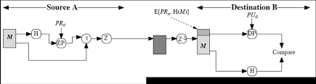
AUTHENTICATION ONLY

Slide 7
CONTD…
The sender generates a message and a random 128-bit number to be used as a session key for this message only.
The message is encrypted using CAST-128 (or IDEA or 3DES) with the session key.
The session key is encrypted with RSA using the recipient’s public key and is prepended to the message.
The receiver uses RSA with its private key to decrypt and recover the session key.
The session key is used to decrypt the message.

Slide 8
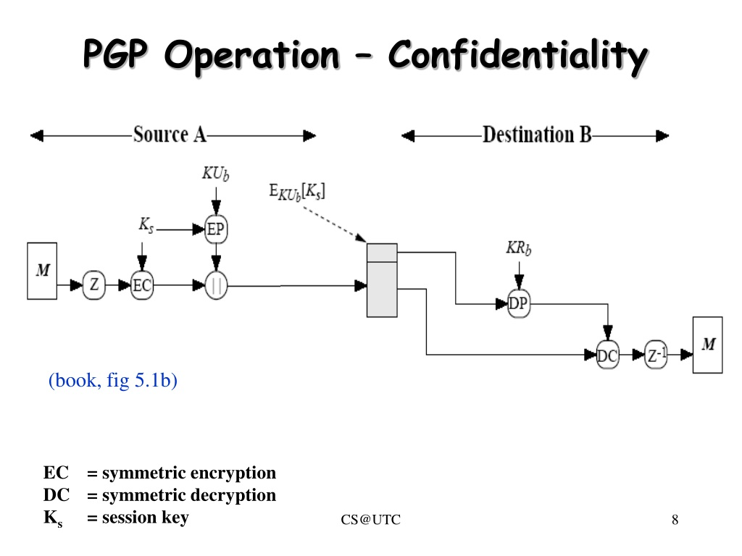
CONFIDENTIALITY ONLY

Slide 9
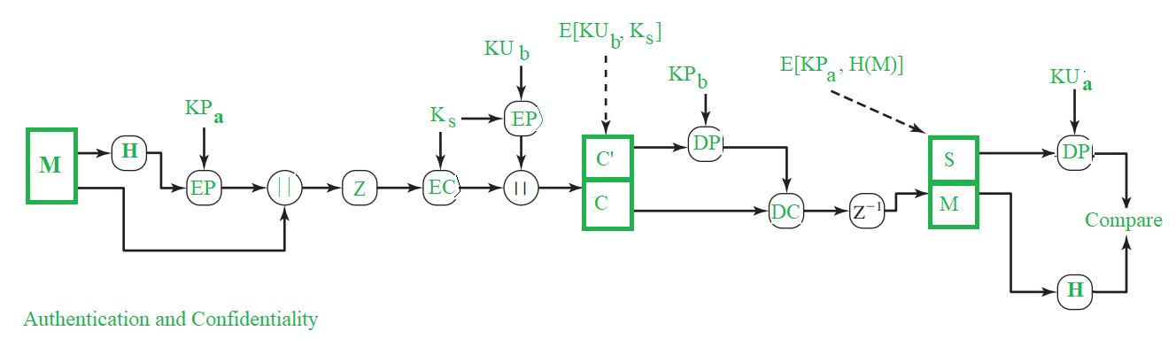
AUTHENTICATION & CONFIDENTIALITY

Slide 10
COMPRESSION
PGP compresses the message after applying the signature but before encryption. This has the benefit of saving space both for e-mail transmission and for file storage.
The placement of the compression algorithm, indicated by Z for compression and Z⁻¹ for decompression.
The signature is generated before compression for two reasons:
→It is preferable to sign an uncompressed message so that one can store only the uncompressed message together with the signature for future verification.
→Even if one were willing to generate dynamically a recompressed message for
verification, PGP’s compression algorithm presents a difficulty.
Message encryption is applied after compression to strengthen cryptographic security

Slide 11
E - MAIL COMPATIBILITY
When PGP is used, at least part of the block to be transmitted is encrypted. If only the signature service is used, then the message digest is encrypted (with the sender’s private key). If the confidentiality service is used, the message plus signature (if present) are encrypted (with a one-time symmetric key).

